Slide 1
We’re gunna attack!

Slide 2
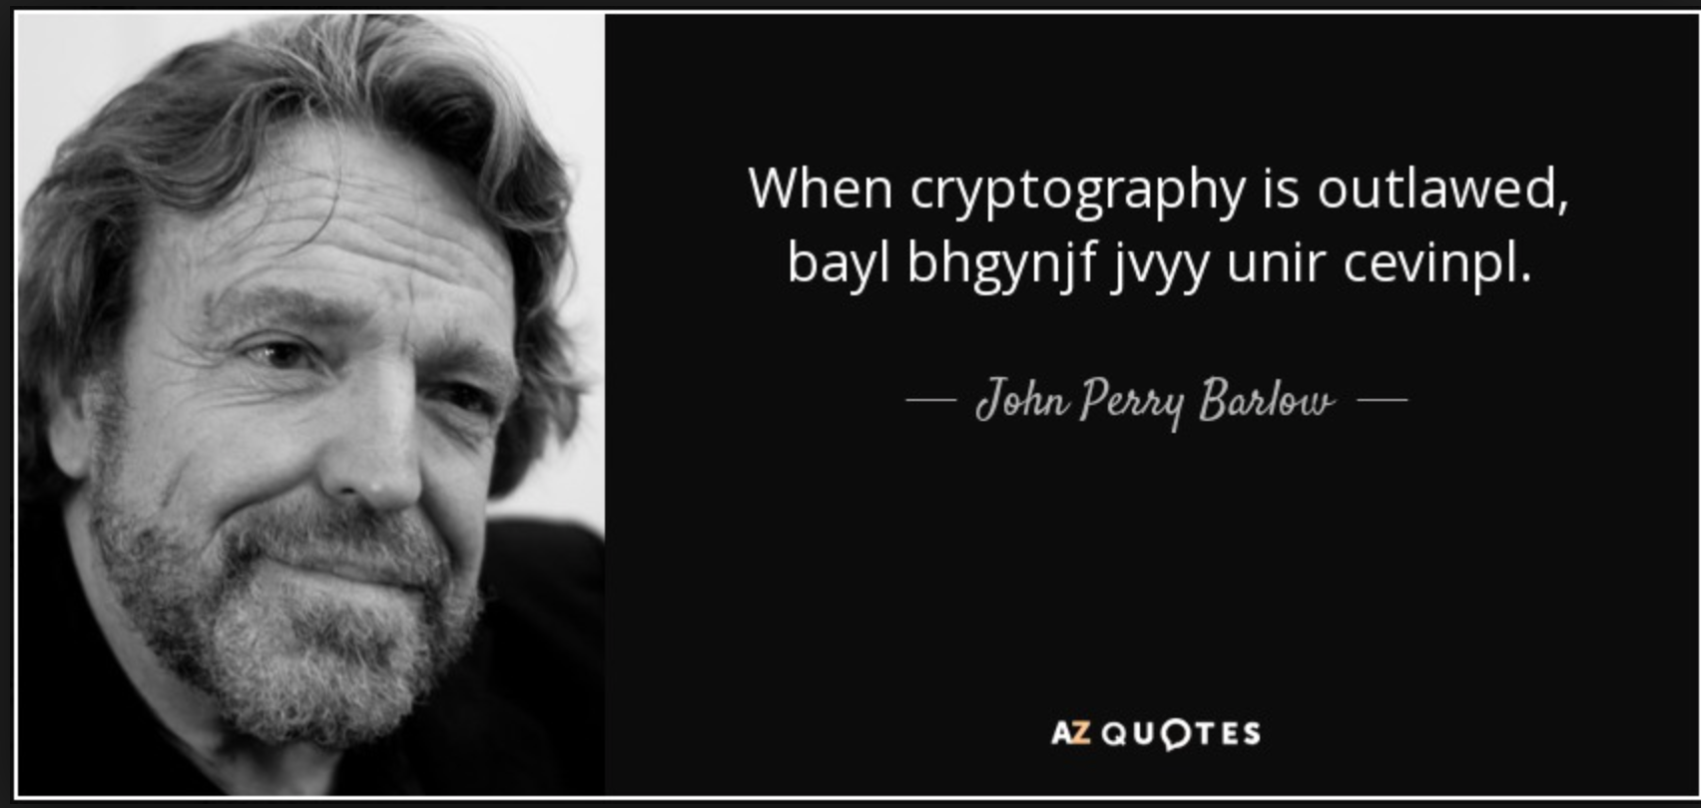
But first let’s review

Slide 3
1.
Perfect Secrecy
What is it?

Slide 4
Perfect secrecy is the notion that, given an encrypted message (ciphertext) from a perfectly secure encryption system (or cipher), absolutely nothing will be revealed about the unencrypted message (plaintext) by the ciphertext.

Slide 5
What do we keep secret?
The encryption algorithm
The ciphertext
The time the message will be sent
NONE OF THE ABOVE!!
Why?

Slide 6


THE KEY
The only thing we can try to keep safe!

Slide 7
Key Exchange Methods
Diffie Hellman
(gª mod p)^{b} mod p = g^{ab} mod p
(g^{b} mod p)ª mod p = g^{ba} mod p
RSA
Ask about the math later if you care

Slide 8

Now we’ve covered the basics
Can you think of any ways all of the extra measures of security might not be enough?

Slide 9
Uh-Oh. I’m bad at sending messages.
“Let’s meet at Starbucks”
“Sorry, I was napping”
“Gotta study”

Slide 10

Why can this be attacked?

Slide 11
BRUTE FORCE
DUN DUN DUN

Slide 12
As an attacker, what do I do?
Get my hands on the ciphertext
Know what encryption scheme is used
Encrypt the 3 possible messages and compare to the ciphertext!

Slide 13

Let’s try it!
Coding time
Yay. live, love, laugh, crypto, coding, cs, #codebreakers

